Slide 1

COMMERCIAL PRESENTATION
January 2019

Slide 2

LOKA has developed a revolutionary solution that gives conscience to your Business Assets. The IoT Solution includes a connected Devices and a Cloud Platform with Geolocation capabilities.
Who we are

Slide 3
Value Proposition
LOW POWER
LOW COST
HIGH VALUE
The IoT Solution for geolocation, temperature and movement monitoring

Slide 4



Value Proposition
Low cost and low power devices with geolocation capabilities.
Reduced integration services, lower operation costs and deployment time.
MARKET NEEDS
LOW POWER
LOW COST
The combination of Sigfox and Wi-Fi requires less power for communication and geolocation, enabling the use of two AA batteries that can last up to 5 years.
Combining the Sigfox network highly affordable communication plans and Wi-Fi geolocation, enables substantial savings on the device acquisition and operation.

Slide 5


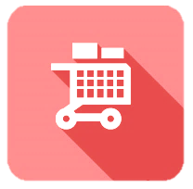


Value Proposition
NEW BUSINESS MODELS
Build a faster time to market, create value added services to customers
REAL-TIME INFORMATION ON MISSION-CRITICAL SYSTEMS
Capture data on critical processes that can change the way you run your business.
DIVERSIFICATION OF REVENUE STREAMS
The latest IoT technology enables the creation of new revenue streams for your company.
GLOBAL VISIBILITY
Access your business information from anywhere in the world.
EFFICIENT, INTELLIGENT OPERATIONS
Make informed decisions, based on real-time data from inside your company.

Slide 6
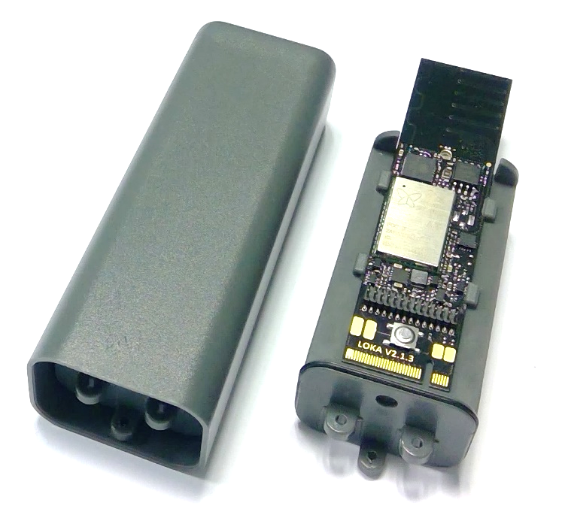
The LOKA Devices sensors do readings of the surrounding environment, indoor and outdoor, and data is then transmitted to the IoT cloud platform, using Sigfox, Bluetooth or Wi-Fi connectivity, according to your personalized notifications. The data can be anything, from temperature, to battery values, to movement detection, and geolocation information.
Product
Hardware
LOKA PRIMIS

Slide 7

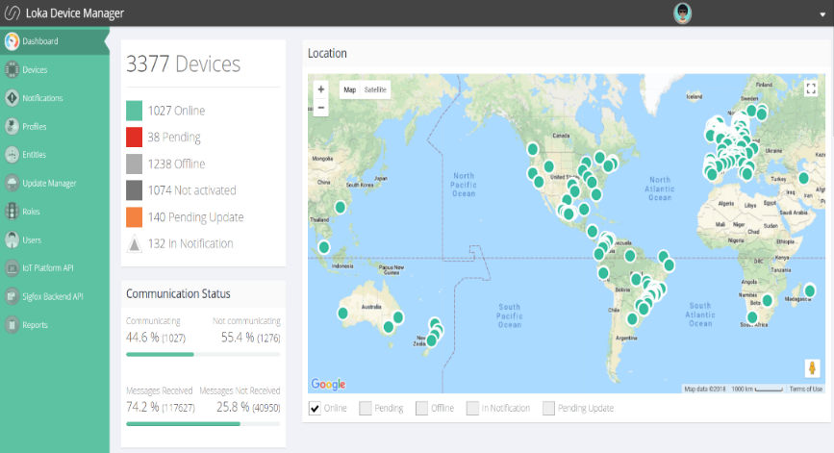
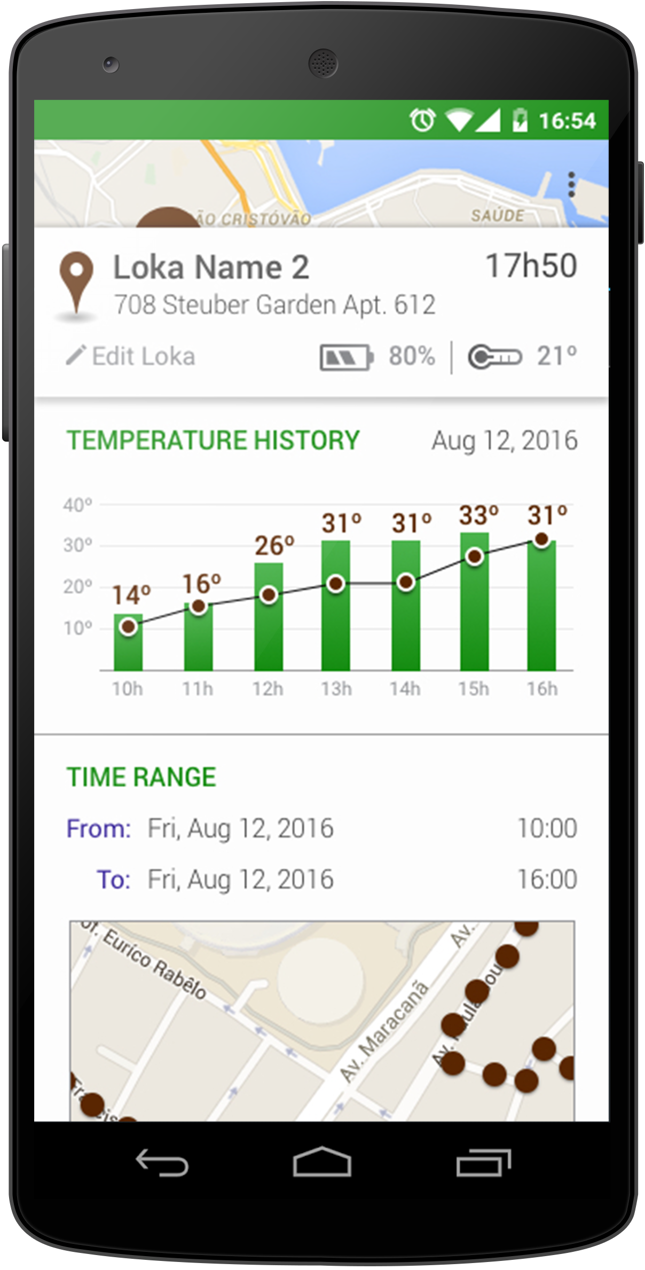
The LOKA Device Manager interprets and translates the data received from the devices, to present it in a user-friendly interface. It enables you to track and get information on any asset, or thing, you want to monitor.​
Product
Software
LOKA MIND

Slide 8




Product
Firmware
One device Firmware, multiple Applications
Tracking
Alarms
Data Logging
Statistics

Slide 9
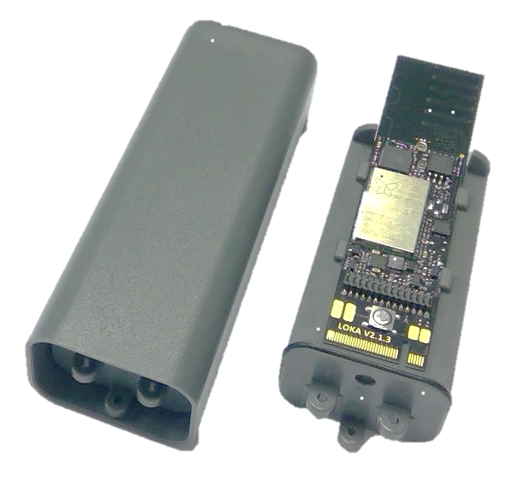
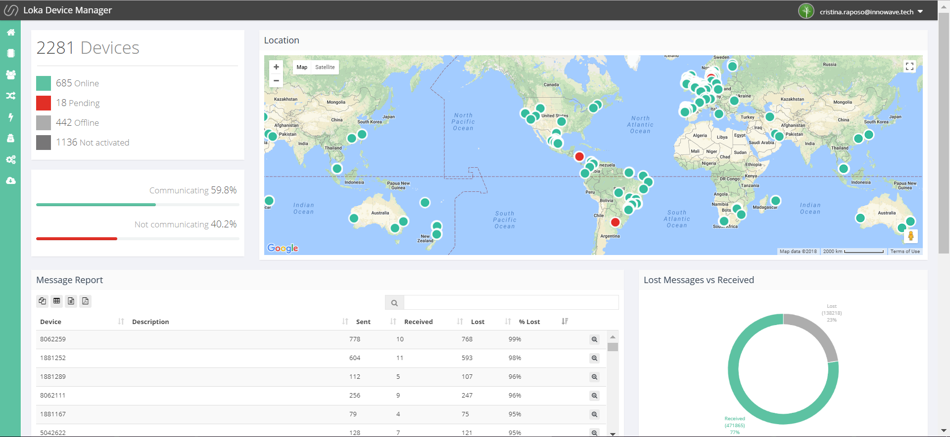

How it works

Slide 10
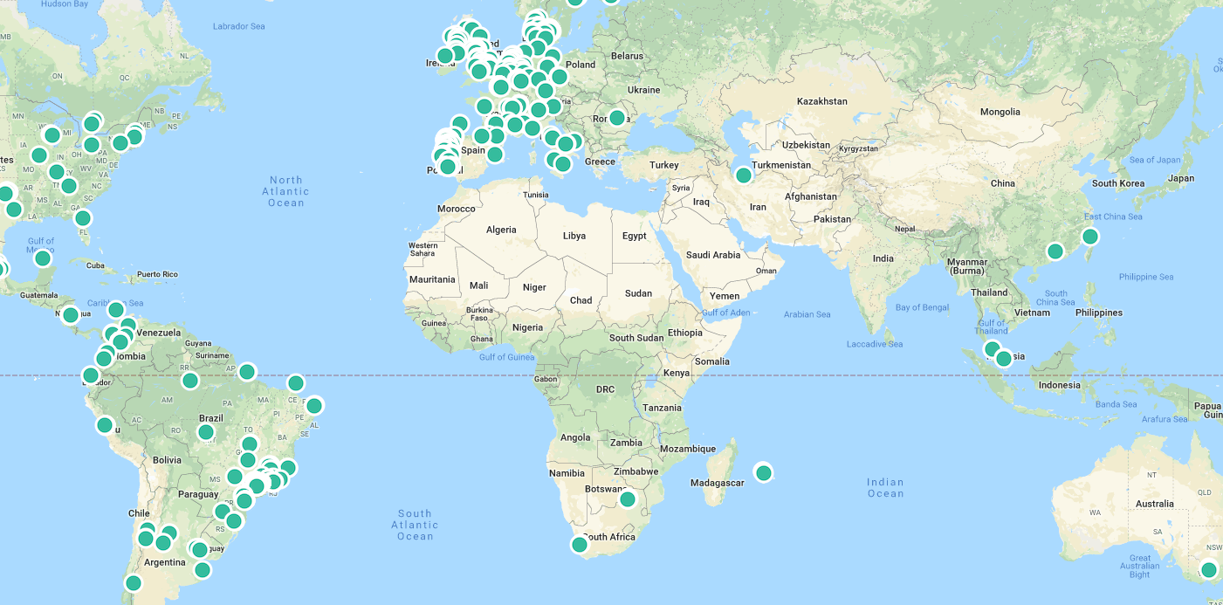
This enables you to track and get information on any asset, or thing, you want to monitor.​

Slide 11
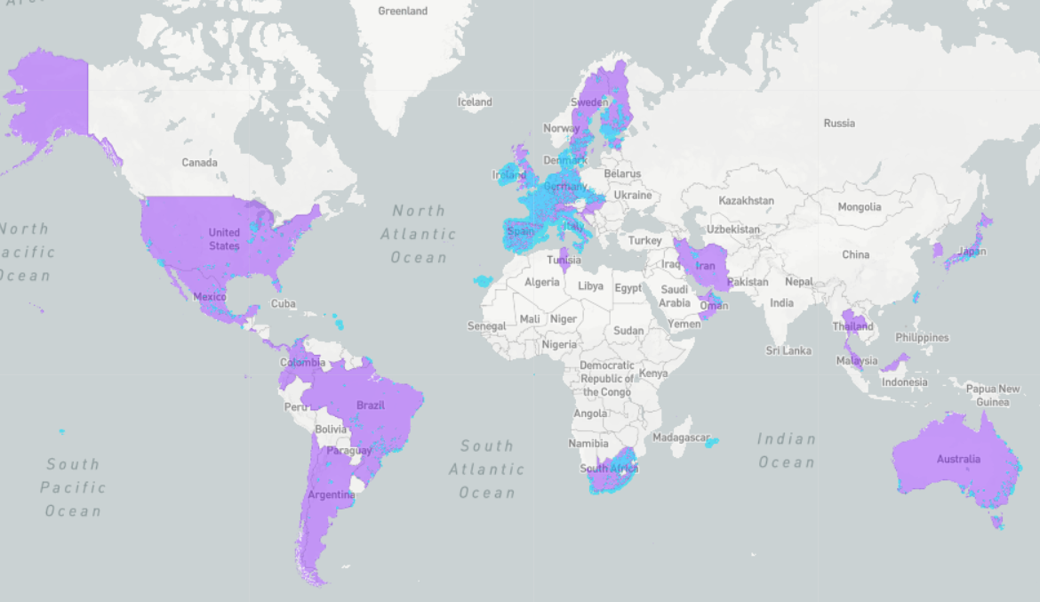

The Sigfox network is the world’s leading provider of narrow-band connectivity for the Internet of Things (IoT). Sigfox provides extremely price-competitive connectivity subscriptions and even more importantly, enables extremely simple and cost-efficient silicon modules.

Slide 12



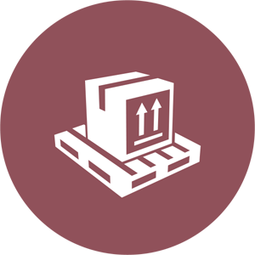

Main Use Cases
FOOD SUPPLY CHAIN
Tracking and Monitoring
SECURITY
Door opening
Movement detection
Asset tracking
ENERGY
Cannister tracking and gas level detection
LOGISTICS
Shipping crate Tracking
Pallet Tracking
RETAIL
Cold Chain

Slide 13
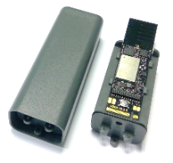

Business Model
LOKA PRIMIS device acquisition
Ranging from 16,00 to 39,50 EUR per device, pricing is dependent on order volume.
With acquisition of the device, we offer the LOKA Mind subscription and geolocation service fee for the first year.
Annual LOKA MIND - device manager Fee
After the first year, an annual service fee applies, per device and per year, for the usage of the IoT Cloud Platform and Geolocation services. Ranging from 0,50 to 2,50 EUR, pricing is dependent on order volume.
This service includes online and remote Support services.
Sigfox Connectivity
LOKA delivers the devices with Sigfox connectivity included. Or you can contact your local Sigfox Network Operator for a connectivity quote.

Slide 14
Want to see more? Connect with us João Tacanho Managing Director joao.tacanho@loka-systems.com Cristina Raposo Head of Sales & MKT cristina.raposo@loka-systems.com

